Slide 1

Munchy Gourmet Recommendation System
Advisor:
洪復一
陸玟臻、洪詠豐、陳銘澤
、曾博彥、黃安氏原
Team Members

Slide 2
Outline
Motivations/ Goals
System Analysis and Design
System Architecture
Data Collection
Transferring Data
Data Processing
User Interface
Demonstration
Conclusion

Slide 3
Motivations & Goals
MOTIVATIONS
The rising percentage of “Fast-Food Junkies”.
Massive information to make decisions
GOALS
To create a personalized recommendation system for users

Slide 4
System Analysis and Design

Slide 5
System Design
Our system is aimed to provide below functions:
Friendly User Interface
Recommend based on
Locations
Distance
Months or Seasons
Food Types
User Ratings

Slide 6
System Architecture
User
Data
Processing
User Interface
Data
Collection
Database
Web Site

Slide 7
System Analysis and Design -- Data Collection

Slide 8
Data Collection Subsystem
Purpose:
To provide a set of data for the system
Steps:
Collect data through the internet
Use collected data as our system input
Store collected data into our database system

Slide 9
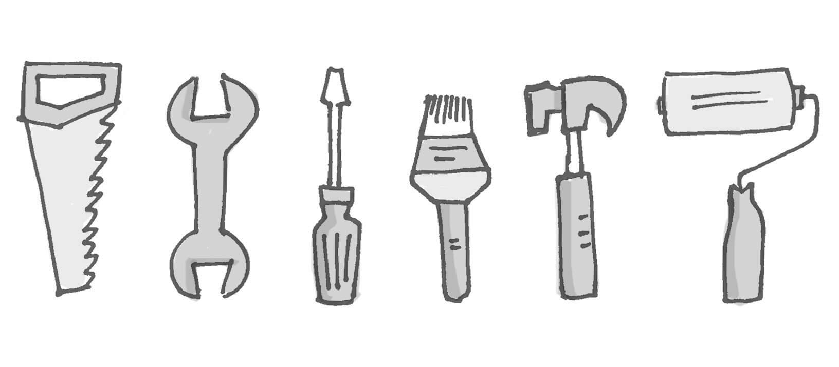
Protocols and Tools
Send “requests” to http server ex. Get, Post
BeautifulSoup4 ➔ crawling data
SQLAlchemy ➔ Python ORM framework

Slide 10
Crawling Procedure
DB
Search All Shops
Shop ID
Shop Details
Comment ID
Shop Reviews/ Reply

Slide 11
Crawling Hierarchy
Get List
Shop ID
Get Detail
ShopID/URL/review intro/ details
Get Comments
Comment ID List, comment, index
Get Review/ Reply

Slide 12
System Analysis and Design -- Transferring Data

Slide 13
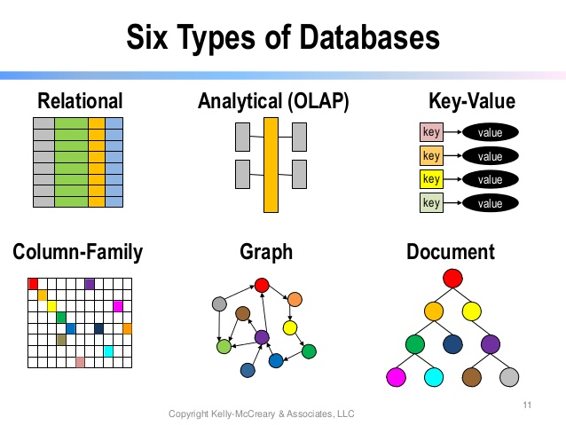
Transferring Database
Transferring traditional database into the graph database
MySQL ➔ NoSQL (Neo4j)

Slide 14
How to Transfer Database
MySQL ➔ NoSQL (Neo4j):
Get csv files exported from MySQL database
Preprocessing to have “clean” data with python, panda package:
Check for null data and drop rows have null data (336 shop doesn’t have price)
Extract day, year, month from timestamp
Extract category and shopId into another table for importing into the database
Extract area(division) from address
Loading the “clean” csv files with neo4j built-in function
Delete any remaining duplicate if found

Slide 15
Why Using Graph DBS?
-Author –Reviews -Restaurants
Construct by Nodes, Relationships and Path patterns
ADVANTAGES
Faster than aggregations in MySQL
Shorter searching time
Rather flexible, data model can be evolved
Therefore, it is easier to achieve function goals

Slide 16
System Analysis and Design -- Data Processing

Slide 17
Data Processing Subsystem
Purpose
Build user recommendations
Steps
Analyze the data pattern
Evolving the initial data model

Slide 18
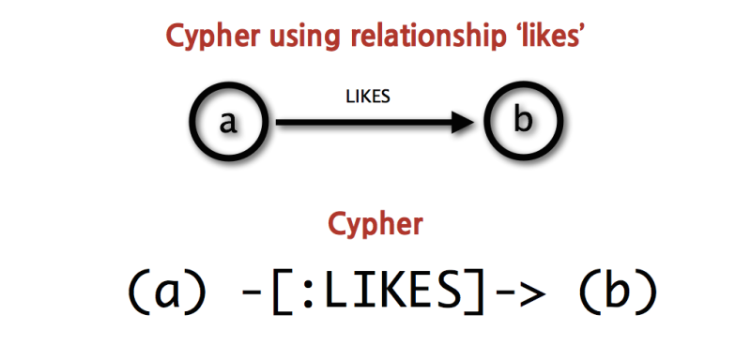
Cypher Neo4j – Nodes and Relationship

Slide 19
Cypher Neo4j - Patterns
friend-of-a-friend (user)-[:KNOWS]-(friend)-[:KNOWS]-(foaf)
shortest path: path = shortestPath( (user)-[:KNOWS*..5]-(other) )
collaborative filtering (user)-[:PURCHASED]->(product)<-[:PURCHASED]-()-[:PURCHASED]->(otherProduct)
tree navigation (root)<-[:PARENT*]-(leaf:Category)-[:ITEM]->(data:Product)

Slide 20
Initial Data Model
-Author –Reviews –Restaurants
–Category -Division
Initially, we have:
5 node types:
Author,
Review,
Restaurants,
Category,
Division
4 relationship types:
(Author)-[:WROTE]->(Review)
(Review)-[:ABOUT]->(Restaurant)
(Restaurant)-[IN_CATEGORY]-(Category)
(Restaurant)-[:IN_DIVISION]-(Division)
WROTE
IN CATEGORY
ABOUT
IN DIVISION

Slide 21
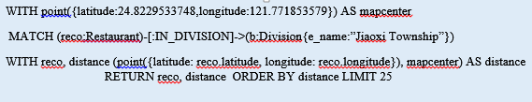
Restaurant Near You
-Author –Reviews –Restaurants
–Category -Division
Case of Usage: Restaurant Near You
Purpose: Recommend restaurant near you
Since Neo4j has built in distance function, we can just use that function to calculate distance between point
User’s latitude and longitude is retrieved into query for fast
WROTE
IN CATEGORY
ABOUT
IN DIVISION

Slide 22
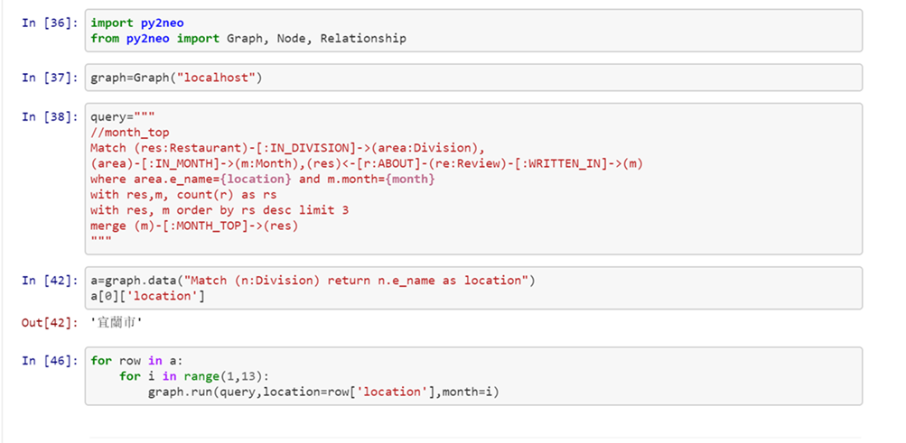
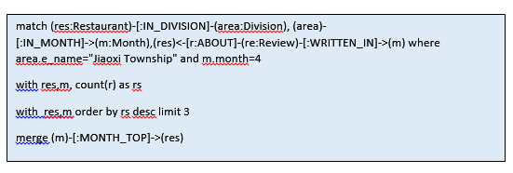
Top Restaurant for Each Month
-Division –Month –Restaurant -Reviews
Case of Usage: Top Restaurant(Most Reviewed) for each month
Purpose: Recommend popular restaurant of the month, the Season,
For each division, choose the restaurants with the number highest number of reviews limit to 3 and connect to the corresponding month with TOP_MONTH relationship
IN DIVISION
IN_MONTH
ABOUT
WRITTEN IN

Slide 23
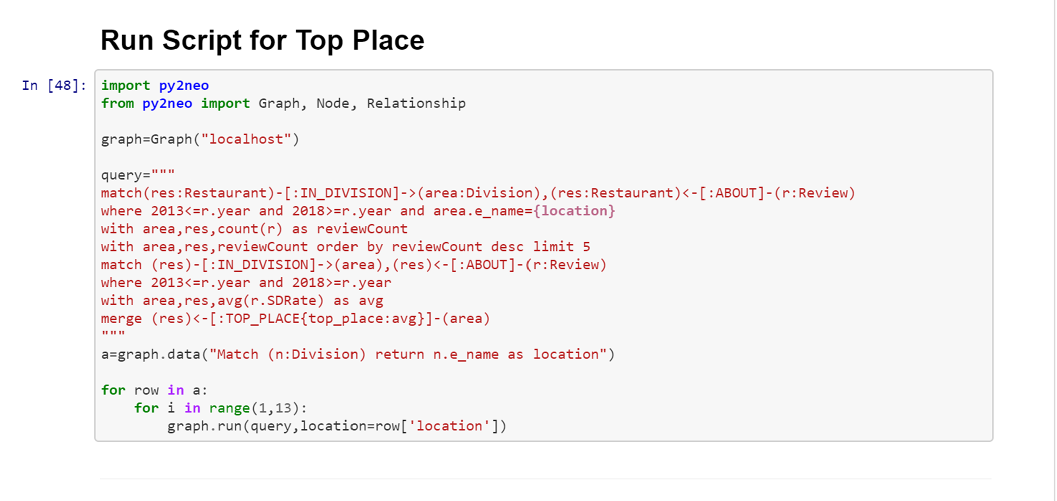
Top Places in Each Division
-Division –Restaurant –Reviews
Case of Usage: Top Places(most reviewed) in each division
Purpose: popular restaurants in recent years
•collect the review of restaurant in recent years
•limit them to top 5
•in top 5, calculate the avg of review rating during recent years
•create a [:TOP_PLACE] relationship from res to the division for later quick query
TOP_PLACE

Slide 24
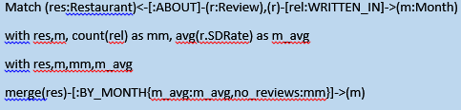
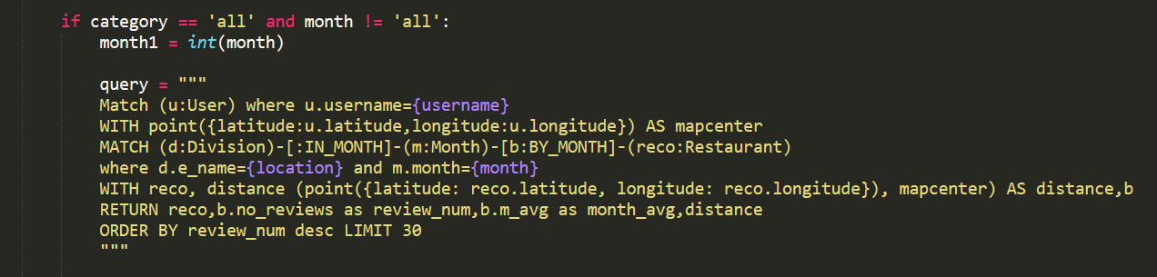
Restaurant Tendency Towards Certain Month
PIC
Case of Usage: Restaurant Tendency Towards a Certain Month
Purpose: for general recommendation and ranking in season
review
res
month

Slide 25
RELATING RESTAURANT
-Author –Reviews -Restaurants
Case of Usage: Show Relating Restaurant
Purpose: Recommend at the end of the page for users
(Restaurant)-[RATED]-(Author)-[RATED]-(Restaurant)
From RATED relationship, construct NEIGHBOR relationship
(Restaurant)-[NEIGHBOR]-(Restaurant)
->shortest weighted path here to find the relating restaurant

Slide 26
System Analysis and Design -– User Interface

Slide 27
User Interface Subsystem
Purpose
Provide recommendations to the user
Steps
User ➔ User Interface ➔ Database
User ⬅ User Interface ⬅ Database

Slide 28
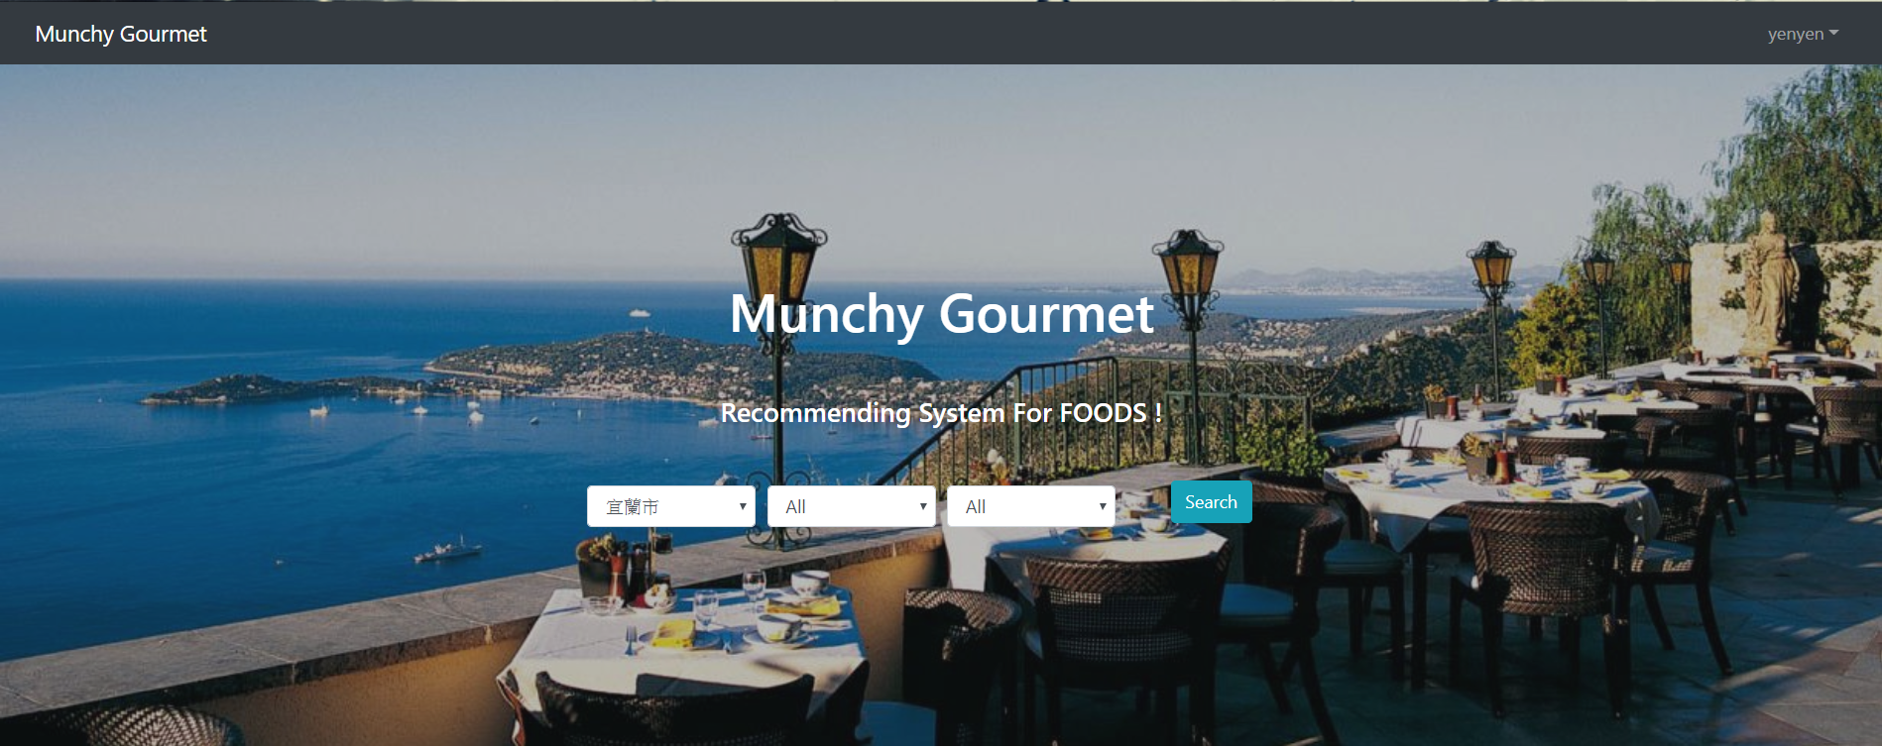
User Interface

Slide 29
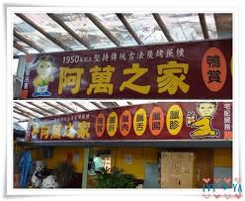
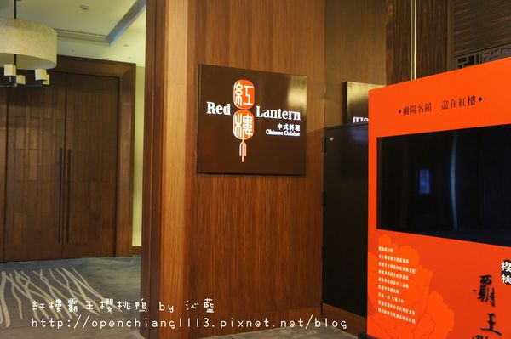
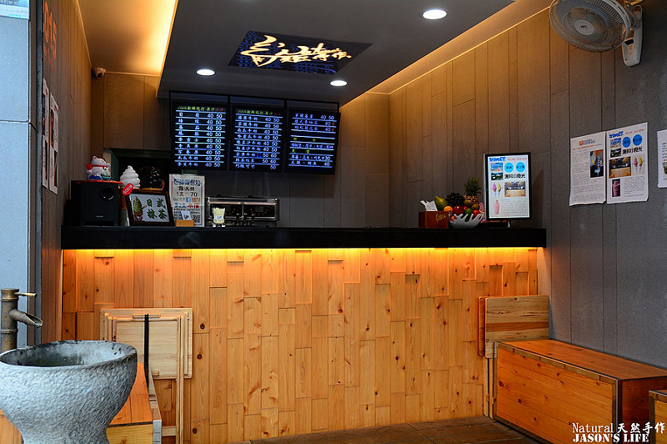
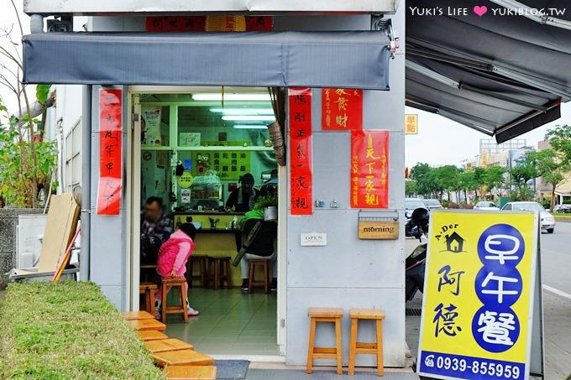
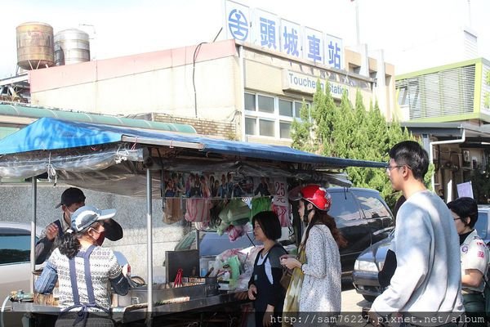
Restaurant in summer TOP 5

Slide 30
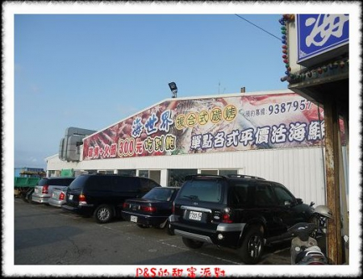
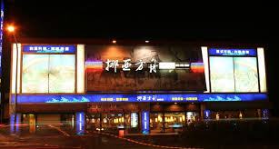
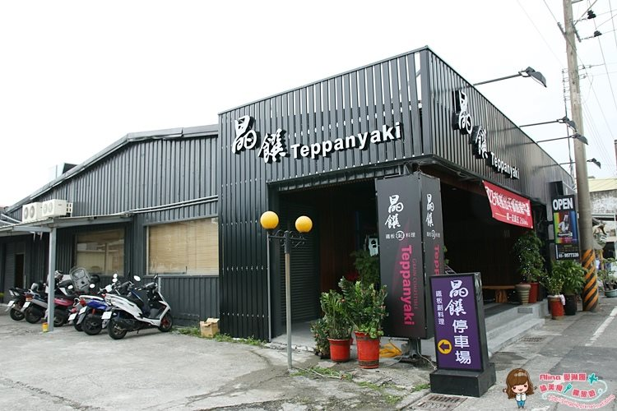
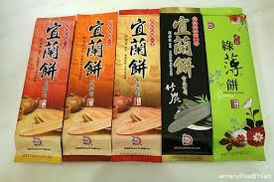
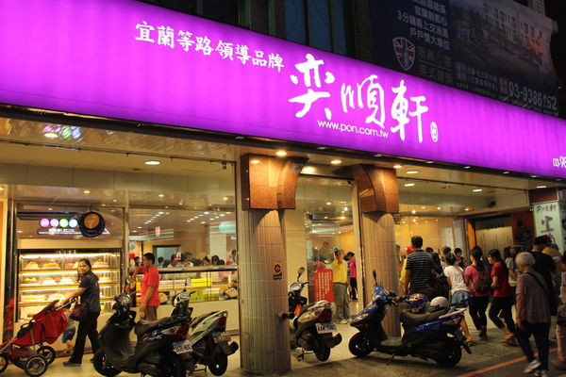
Restaurant in winter TOP 5

Slide 31
Demonstration

Slide 33
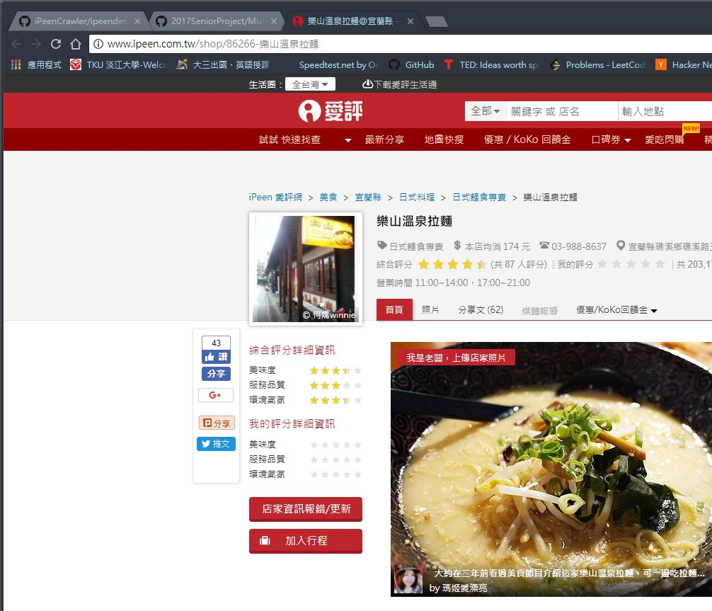
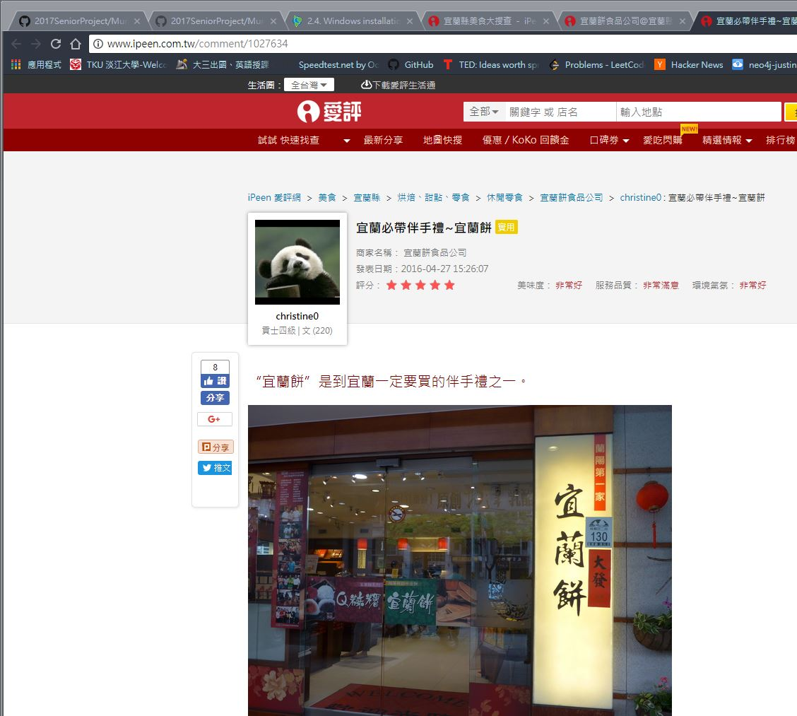
First Step : Analyze Web URL
Notes:
Different shop different ID

Slide 34
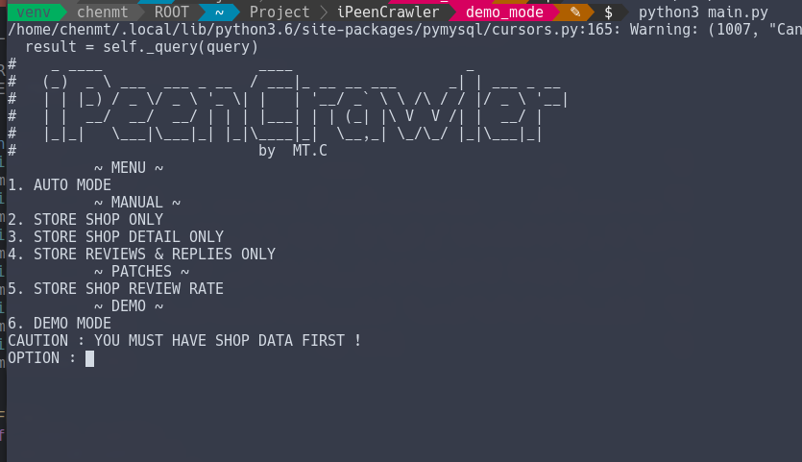
First Step : Analyze Web URL
http://www.ipeen.com.tw/shop/40797
http://www.ipeen.com.tw/comment/1027634

Slide 35

First Step : Analyze Web URL
Static Webpage
-> Requests (Python HTTP Package)
Analyze and extract Webpage data
-> Python + Beautiful Soup (Pulling data out of HTML)
Storing Data
-> Pymysql (sql driver for Python3 + )
-> SqlAlchemy (Object-Relational Mapper (ORM) for python)

Slide 36
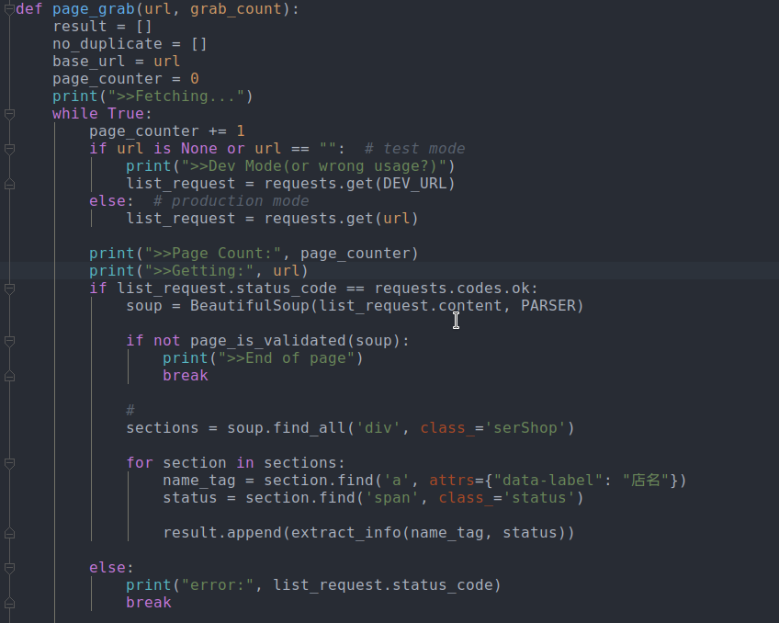
Second Step : Grabbing Pages by <HTML> Tag

Slide 37
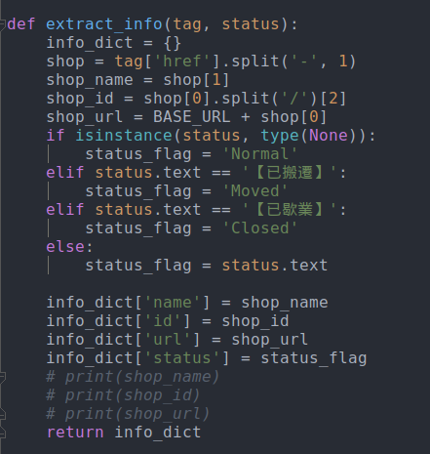
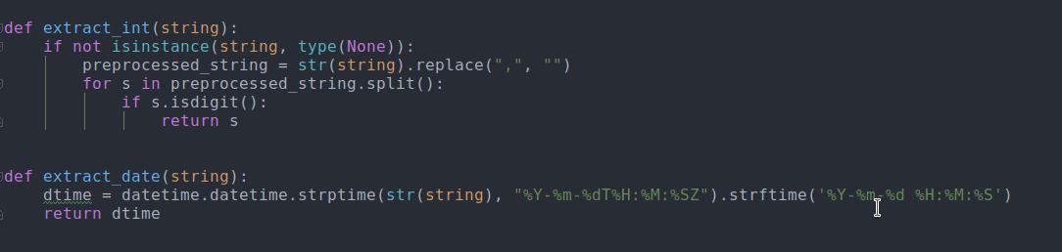
Third Step : Extract from RAW data

Slide 38
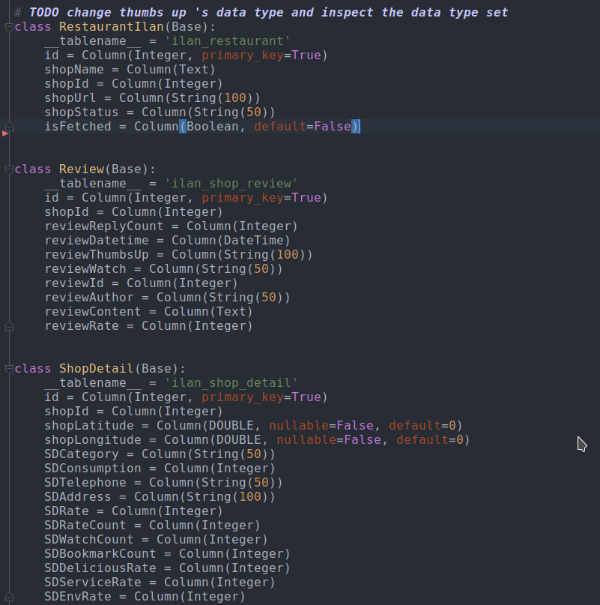
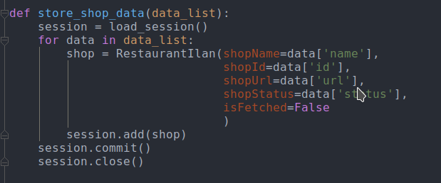
Forth Step : Store into Database

Slide 39
Conclusion

Slide 40
Conclusion
We construct a recommendation system
Collect data from iPeen
Construct the data model of this recommendation system
Provide personal recommendation to the user
System Characteristic
Update automatically
Friendly and personalized User Interface
Recommend by user locations, seasons, preference, etc.

Slide 41
Questions?

Slide 42
Thank You For Your Time!

Slide 43
Data Collection Steps
Get sequence, restaurant name, restaurant id and restaurant status (whether it’s moved, close or normal) then store them in the database
Use restaurant id to fetch furthermore detailed data.
Next, use restaurant id to catch comment and reply, comment id, comment user, reply establish time.
Last comment id to catch responding user, comment and responding time.

Slide 44
Data Collection Rules
Duplication: If duplication happens and function cannot be found, then the system splits or finds build in function in python to compare id and eliminate
Time Transferring: the system will transfer the data into usable form in order to make the DBS receive successfully
Updating: If the restaurant id was changed, the system might keep oriented towards the unreadable page, thus when such scenario happens, the system will get the new shop id and replace the old one.
Page Validation: If the id that’s search on does not exist and keep oriented towards same page with not usable data, the system will then stop fetching the id’s relating data

Slide 45
Template
Type in here

Slide 46
Data Transfer Example
https://github.com/2017SeniorProject/ppt/blob/master/Processing_data.ipynb
Video: Data Preprocessing( do later)
Video: Load data into Neo4j

